Slide 1
Training Feedforward Neural Networks Using Genetic Algorithms
Original paper by David J. Montana and Lawrence Davis.
Presentation by Christian H. Skjellerup and Erik Belhage.

Slide 2
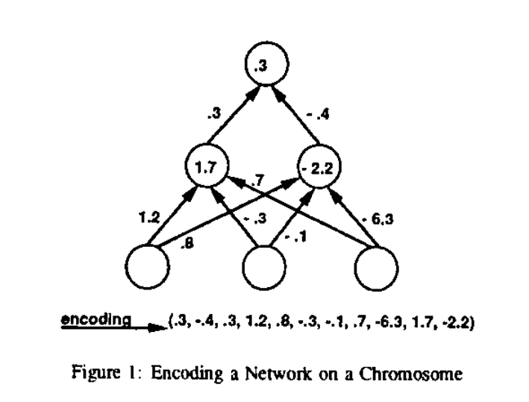
Genetic Algorithms
Inspired by nature and biology, in particular, genetics and evolution.
Requires Independent parameters.
Requires a selection mechanism.
Stepping works through crossover, mutation, cloning, breeding, etc.
Step 1: Encode Step 2: Genetic Operations Step 3: Select

Slide 3
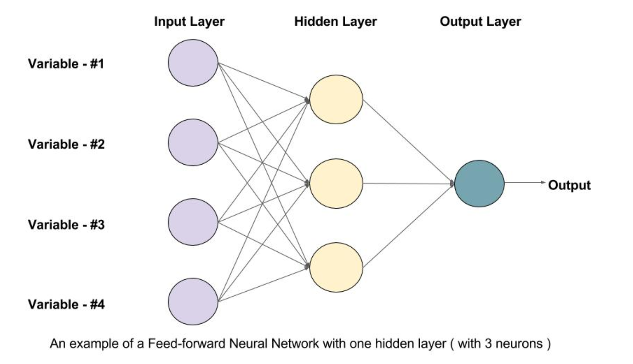
Feedforward Neural Networks
Simple form of neural network
Make classifications.
From learnopencv.com

Slide 4
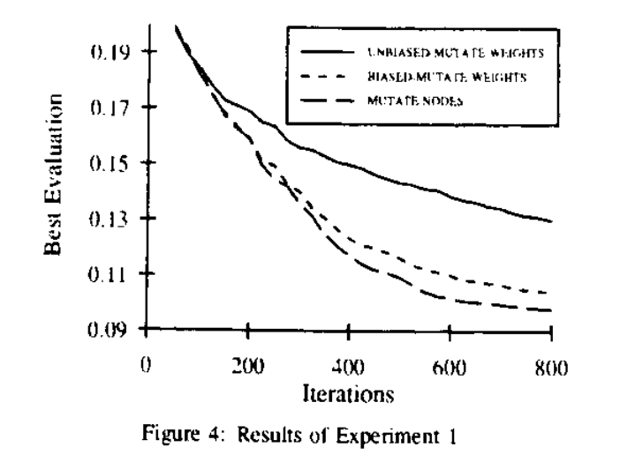
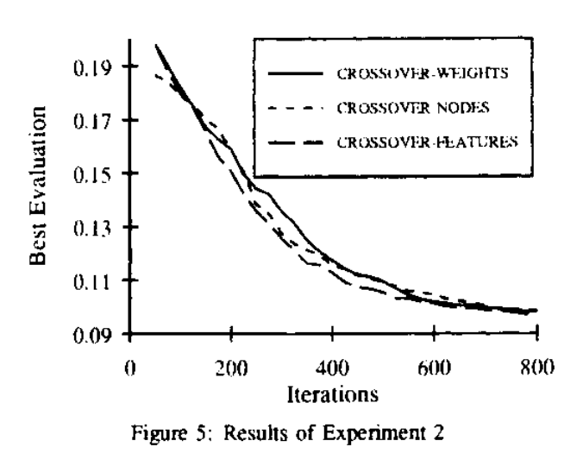
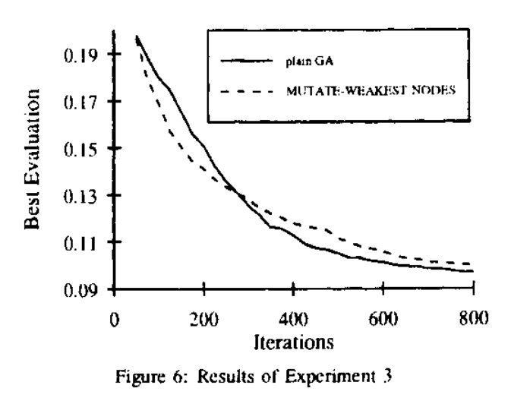
Experiments
A number of experiments were done in the paper to test different kinds of genetic stepping methods, as well as the idea in general.

Slide 5
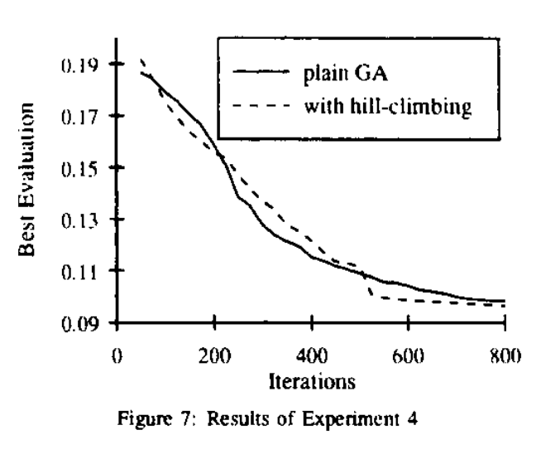
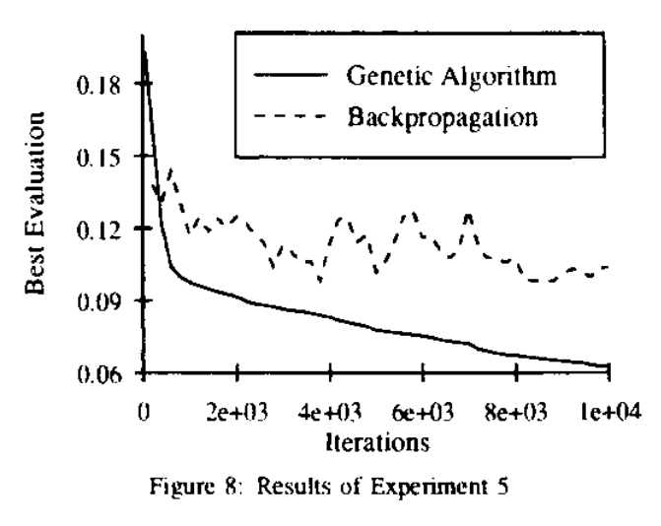
More Experiments

